Slide 1
Introduction to HTML Forms
What is an HTML Form?
HTML Forms are used to collect user input
Data is sent to a server for processing
Used in:
  Login pages
  Registration forms
  Feedback forms
  Search boxes
Syntax
<form>
<!-- form elements -->
</form>

Slide 2
Form Elements:
Common Form Elements
Element | Purpose
input | User input
label | Field name
select | Dropdown
option | Dropdown item
textarea | Multi-line input
button | Click action

Slide 3
Input Types
Important Input Types
text
password
email
number
date
radio
checkbox
file
submit

Slide 4
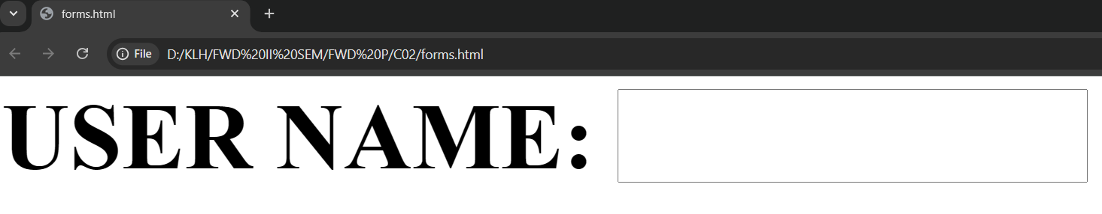
Program: Basic HTML Form:
<html>
<body>
<form>
<label>USER NAME:</label>
<input type="text">
</form>
</body>
</html>

Slide 5
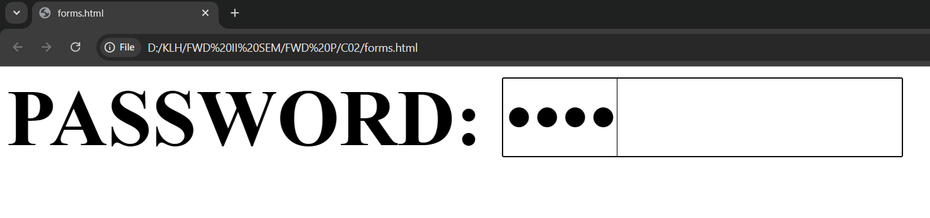
<html>
<body>
<form>
<label>PASSWORD</label>
<input type=“password">
</form>
</body>
</html>

Slide 6
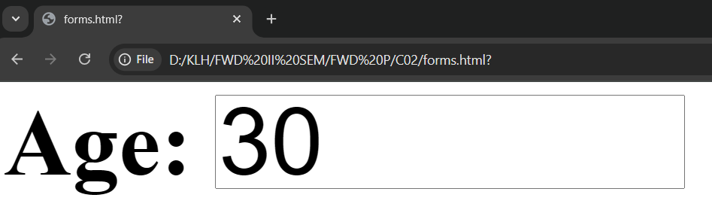
<html>
<body>
<form>
<label>Age:</label>
<input type=“number">
</form>
</body>
</html>

Slide 7
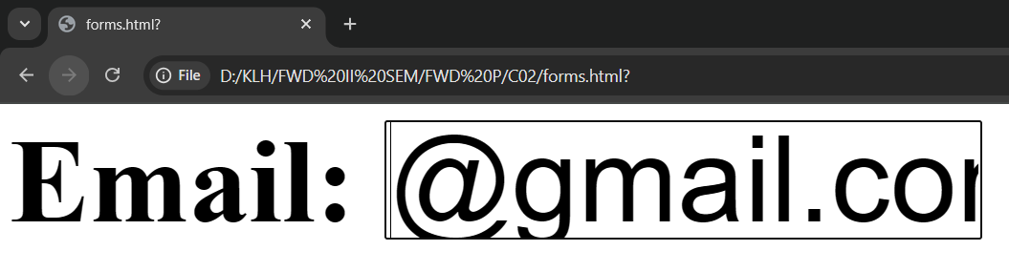
<html>
<body>
<form>
<label>Email:</label>
<input type=“email">
</form>
</body>
</html>

Slide 8
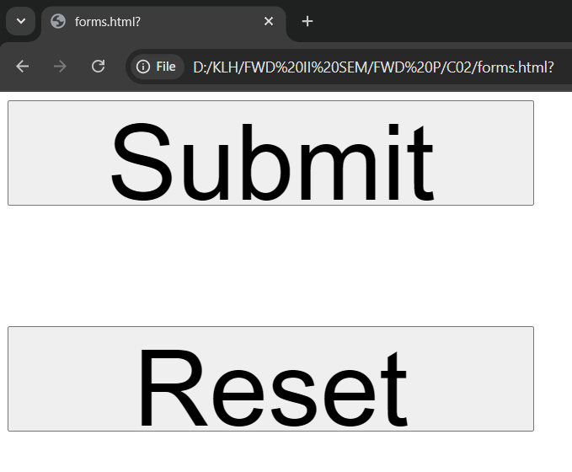
<html>
<body>
<form>
<input type="submit">
<input type=“reset">
</form>
</body>
</html>

Slide 9
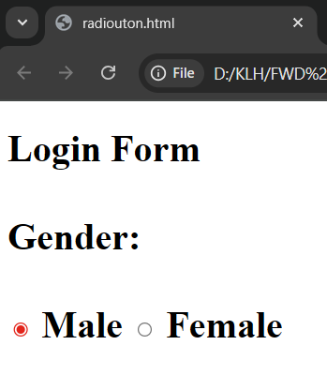
<html>
<body>
<form>
Gender:<br>
<input type="radio" name="gender"> Male
<input type="radio" name="gender"> Female
<br><br>
</form>
</body>
</html>

Slide 10
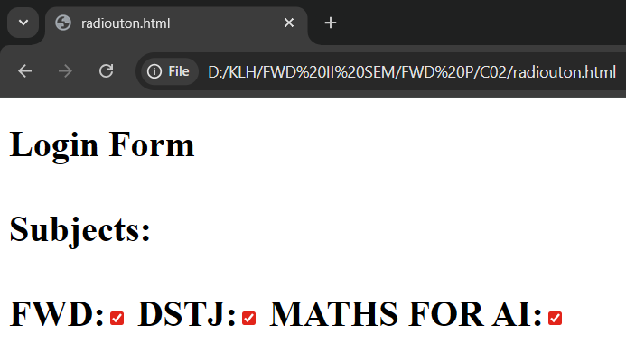
<html>
<body>
<form>
Subjects:<br>
<input type="checkbox"> FWD
<input type="checkbox"> DSTJ
<input type="checkbox"> MATHS FOR AI
</form>
</body>
</html>

Slide 11
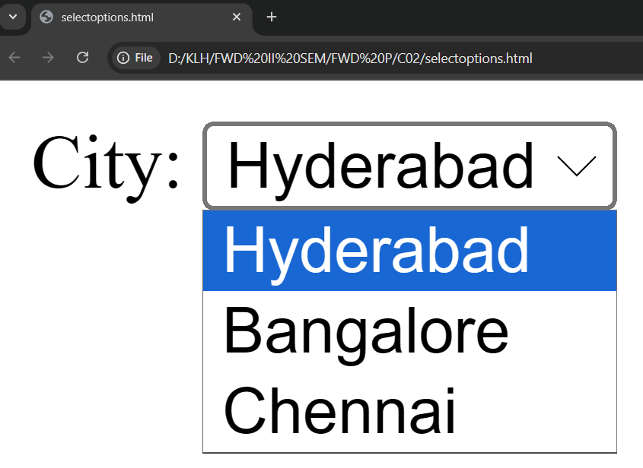
<html>
<body>
<form>
City:
<select>
<option >Hyderabad</option>
<option>Bangalore</option>
<option>Chennai</option>
</select>
</form>
</body>
</html>

Slide 12
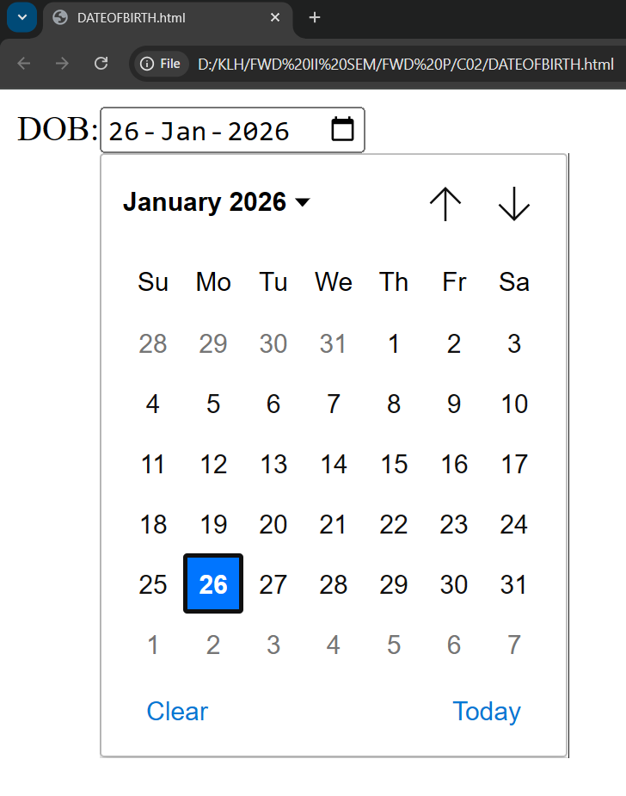
<html>
<body>
<form>
DOB:<input type="date">
</form>
</body>
</html>

Slide 13
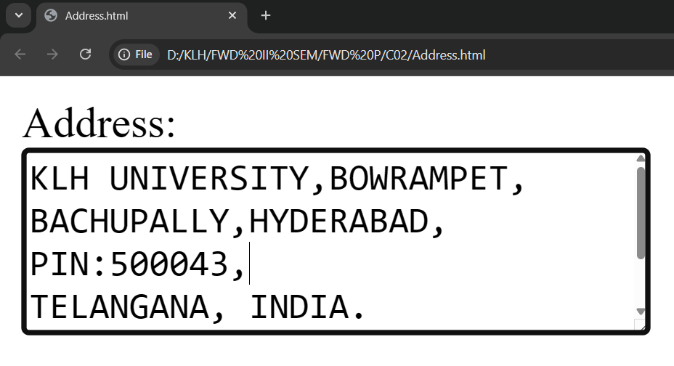
<html>
<body>
<form>
Address:<br>
<textarea rows="4" cols="30"></textarea>
</form>
</body>
</html>

Slide 14
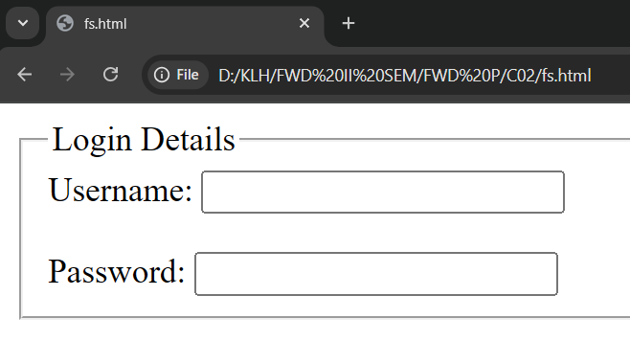
Fieldset:
<html>
<body>
<form>
<fieldset>
<legend>Login Details</legend>
<label>Username:</label>
<input type="text"><br><br>
<label>Password:</label>
<input type="password">
</fieldset>
</form></body>
</html>

Slide 15
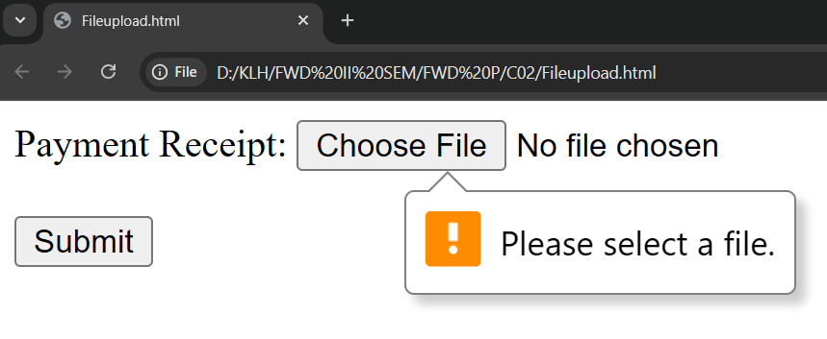
File Upload Option:
<html>
<body>
<form>
Payment Receipt:
<input type="file" required><br><br>
<input type="submit">
</form></body>
</html>

Slide 16
Advanced Input Attributes
Attributes
placeholder
required
readonly
disabled
maxlength
Pattern
Min,max

Slide 17
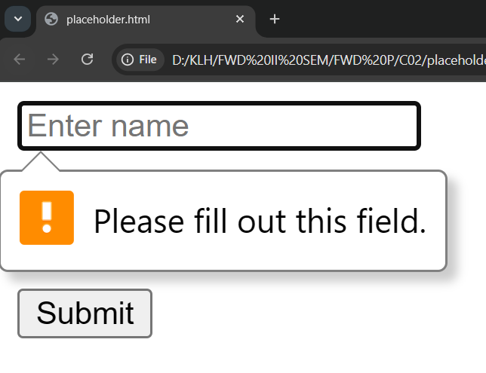
Important Input Attributes
placeholder
required
<html>
<body>
<form>
<input type="text" placeholder="Enter name" required><br><br>
<input type="email" placeholder="Enter email" required><br><br>
<input type="submit">
</form>
</body>
</html>

Slide 18
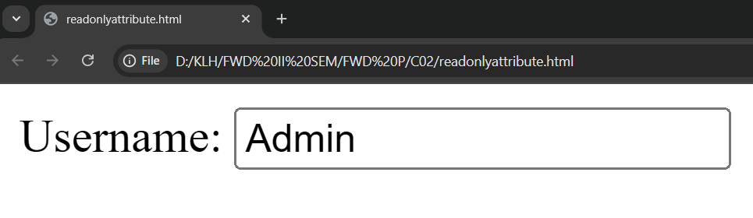
readonly Attribute:
<html>
<body>
<form>
Username:
<input type="text" value="Admin" readonly>
</form>
</body>
</html>

Slide 19
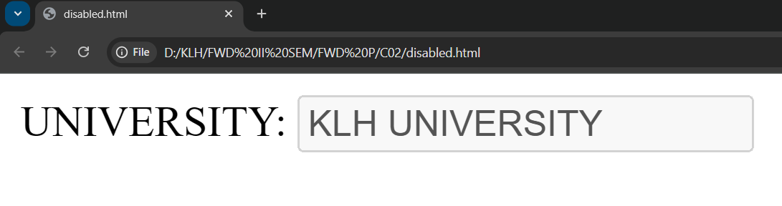
disabled Attribute:
<html>
<body>
<form>
UNIVERSITY:
<input type="text" value="KLH UNIVERSITY" disabled>
</form>
</body>
</html>

Slide 20
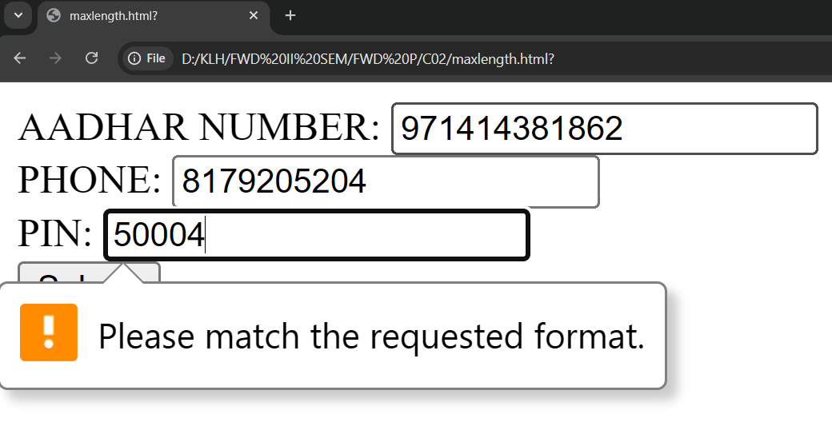
maxlength Attribute:
<html>
<body>
<form>
AADHAR NUMBER:
<input type="text" maxlength="12" pattern="[0-9]{12}" required><br>
PHONE:
<input type="text" maxlength="10" pattern="[0-9]{10}" required><br>
PIN:
<input type="text" maxlength="6" pattern="[0-9]{6}" required><br>
<input type="submit">
</form>
</body>
</html>

Slide 21
maxlength Attribute:
<html>
<body>
<form>
AADHAR NUMBER:
<input type="text" maxlength="12" pattern="[0-9]{12}" required><br>
PHONE:
<input type="text" maxlength="10" pattern="[0-9]{10}" required><br>
PIN:
<input type="text" maxlength="6" pattern="[0-9]{6}" required><br>
<input type="submit">
</form>
</body>
</html>

Slide 22
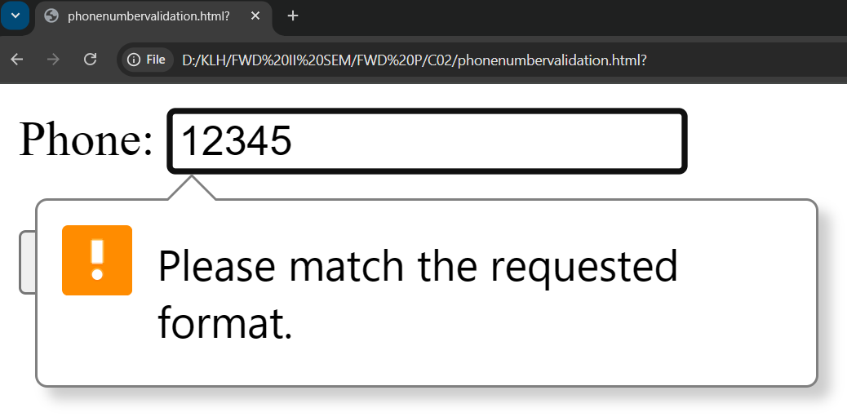
Phone Number Validation Example: (Pattern advanced attribute)
<html>
<body>
<form>
Phone:
<input type="text" pattern="[0-9]{10}" required><br><br>
<input type="submit">
</form>
</body>
</html>

